Slide 1
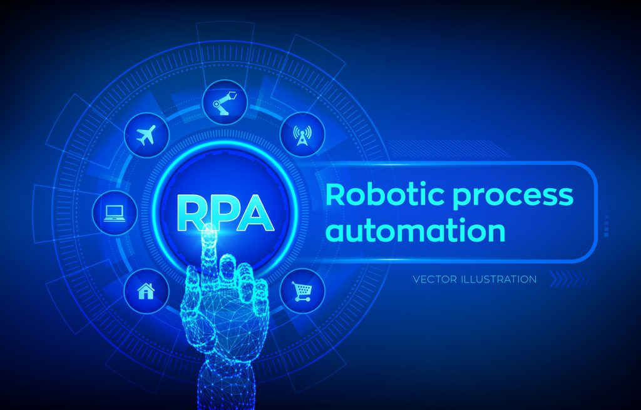

Slide 2
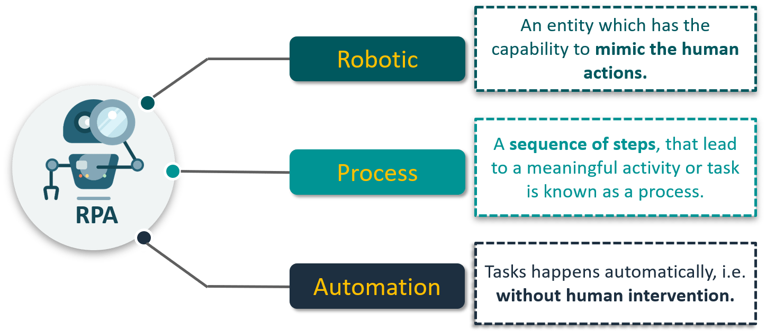
What is RPA?

Slide 3
Automation in Daily Life
Washing Machines
Microwave Ovens
Autopilot mode in Automobiles and Airplanes
Nestle using Robots to sell Coffee Pods in stores in Japan
Walmart Testing drones to deliver products in US
OCR being used by banks to sort bank cheques , etc
Autos Self
Motos Moving

Slide 4
Scope and techniques of automation
What should be automated?
Choosing automation candidates:
Repetitive steps
Time-consuming steps
High-risk tasks
Tasks with a low-quality yield
Tasks involving multiple people and multiple steps
And everything else!

Slide 5
Scope and techniques of automation(cont..)
What can be automated?
Needs to have the following characteristics:
Well defined and rule-based steps
Logical
An input to the task can be diverted to the software system
Input can be deciphered by software systems with available techniques
The output system is accessible
Benefits are more than the cost

Slide 6
Techniques of automation
Custom software -> new software for repetitive tasks
Runbook -> set of commands compiled for common tasks
Batch -> sequence of commands that could be run by a single click or command
Wrapper -> Wraps around existing software
Browser automation -> read from a website and save to a database
Desktop automation -> acting like a human operator, directly controlling a desktop interface
Database/web service integration -> we read/write to a client database/we communicate with the client system using a web service

Slide 7
Benefits of RPA
The following industries can benefit a lot from RPA:
Business process outsourcing (BPO) - Depend less on outsourced labor
Insurance - Managing policies, to filing and processing claims across multiple platforms
Financial sector - Day-to-day activities and handling an enormous amount of data, to performing complex workflows
Utility companies - Meter reading, billing, and processing customer payments.
Healthcare - Data entry, patient scheduling, and more importantly billing, optimizing patient appointments, sending them automatic reminders

Slide 8
Benefits of RPA(contd….)
The following are the benefits of RPA:
Higher quality services, greater accuracy - reduced human error, greater the quality of work
Improved analytics - oftware Robots can log each action taken with the appropriate tag and metadata
Reduced costs - Robot is equivalent to three human full-time executives (FTE)
Increased speed - Better response times and an increase in the volume of the tasks being performed
Greater compliance - Robots do not deviate from the defined set of steps to be taken while doing a task
Agility - Reducing and increasing the number of Robot resources requires managing the volume of the business process.
Comprehensive insights - Broad scope or content,hence better decisions can be made for the improvement of the business
Versatility - Wide range of tasks from small to large businesses, simple to complex processes.

Slide 9
Benefits of RPA(contd….)
Simplicity - RPA does not need prior programming knowledge. Most platforms provide designs in the form of flowcharts.
Scalability - Robots can be quickly deployed at zero or minimum costs while maintaining consistency in the quality of work
Time savings – Quick performance .Technology upgrade it is much easier and faster for the virtual workforce to adapt to the changes
Non-invasive - works at the user interface - helps in reducing risks and complexities
Better management - Allows for managing, deploying, and monitoring Robots through a centralized platform
Better customer service - Robots can work around the clock, capacity increases. Better quality of services delivered to customers at faster speeds greatly boosts customer satisfaction.
Increased employee satisfaction - Frees humans from tedious, mind-numbing work, giving us an opportunity to engage in much more satisfying jobs

Slide 10
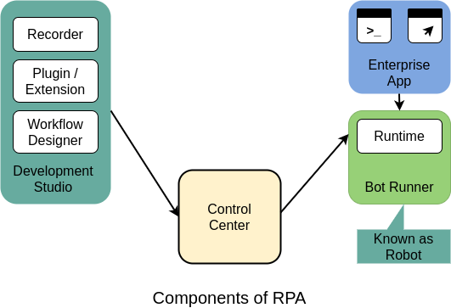
Components of RPA
Any Robotics process automation platform provides some basic components, which together build the platform.

Slide 11
Components of RPA(Contd…)
The following are the basic or core components of RPA:
Recorder - Records steps. It records mouse and keyboard movements on the UI and this recording can be replayed to do the same steps again and again.
Development Studio –
The development studio is used by developers to create Robot configuration or train the Robots.
fair amount of knowledge of programming, for example, loops, if else, variable assignment, and so on
Plugin/Extension –
Many applications, such as Java SAP, it is not easy to individually identify controls of the UI through traditional techniques.
RPA vendors have developed plugins and extensions to help with these issues.
Bot Runner - This is also referred to as the Robot, other components make it run
Control Center –
It can be used to start/stop Robots, make schedules for them, maintain and publish code, redeploy Robots to different tasks, and manage licenses and credentials

Slide 12
RPA platforms
Automation Anywhere
UiPath
Blue Prism
WorkFusion
Thoughtonomy

Slide 13
UiPath Platform
UiPath is an RPA vendor that provides software to help organizations automate their business processes.
The company aims to do away with repetitive and tedious tasks, allowing humans to engage in more creative and inspiring activities.
IT sector is also gradually embracing UiPath's software.
Major clients of UiPath:
BFSI(Banking, financial services and insurance)
Telecom and media
Healthcare
retail and consumer
Manufacturing

Slide 14
UiPath Platform(Contd…)
With UiPath automation software, one can configure software Robots to mimic human action on the user interface of computer systems.
Basic components of the UiPath RPA platform are:
UiPath Studio
UiPath Studio helps users with no coding skills to design Robotic processes in a visual interface
It is a flowchart-based modeling tool
UiPath Robot:
UiPath Robot runs the processes designed in UiPath Studio
Attended (working only on human trigger)
Unattended environments (self-trigger and work on their own)
UiPath Orchestrator:
UiPath Orchestrator is a web-based platform that runs and manages Robots.
It is capable of deploying multiple Robots, and monitoring and inspecting their activities

Slide 15
The future of automation
Throughout the history of human civilization, there has been many major turning points in innovation and discoveries that have instilled awe as well as fear in the minds of people
People Strongly opposed Textile mills then which is called First Industrial Revolution
Fourth Industrial Revolution the current age where technology is embedded within societies and even the human body
Be it Robotics, 3D printing, nanotechnology, Internet of Things, or autonomous vehicles.
This will fundamentally change the way we live, work, and interact with one another.

Slide 16
The future of automation(Contd…)
Technological innovation has reached a stage where machines have now entered the realm of what was once considered exclusively human.
For these reasons, there is a wide section of people who fear this age of Robots which might replace several jobs
Risky Jobs - telemarketing, data entry operation, clerical work, retail sales, cashiers, toll booth operators, and fast food jobs.
While this is not untrue, reports suggest that only around 5% of the total jobs may be totally replaced by automation.
The next generation should be taught how to recognize and adapt to changes quickly.
An important aspect of their education should be to learn how to learn.

Slide 17
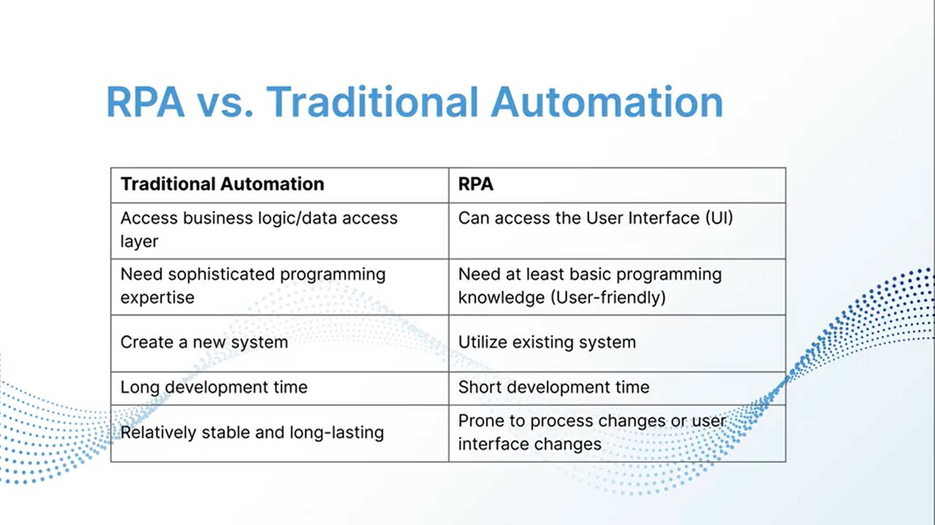

Slide 18
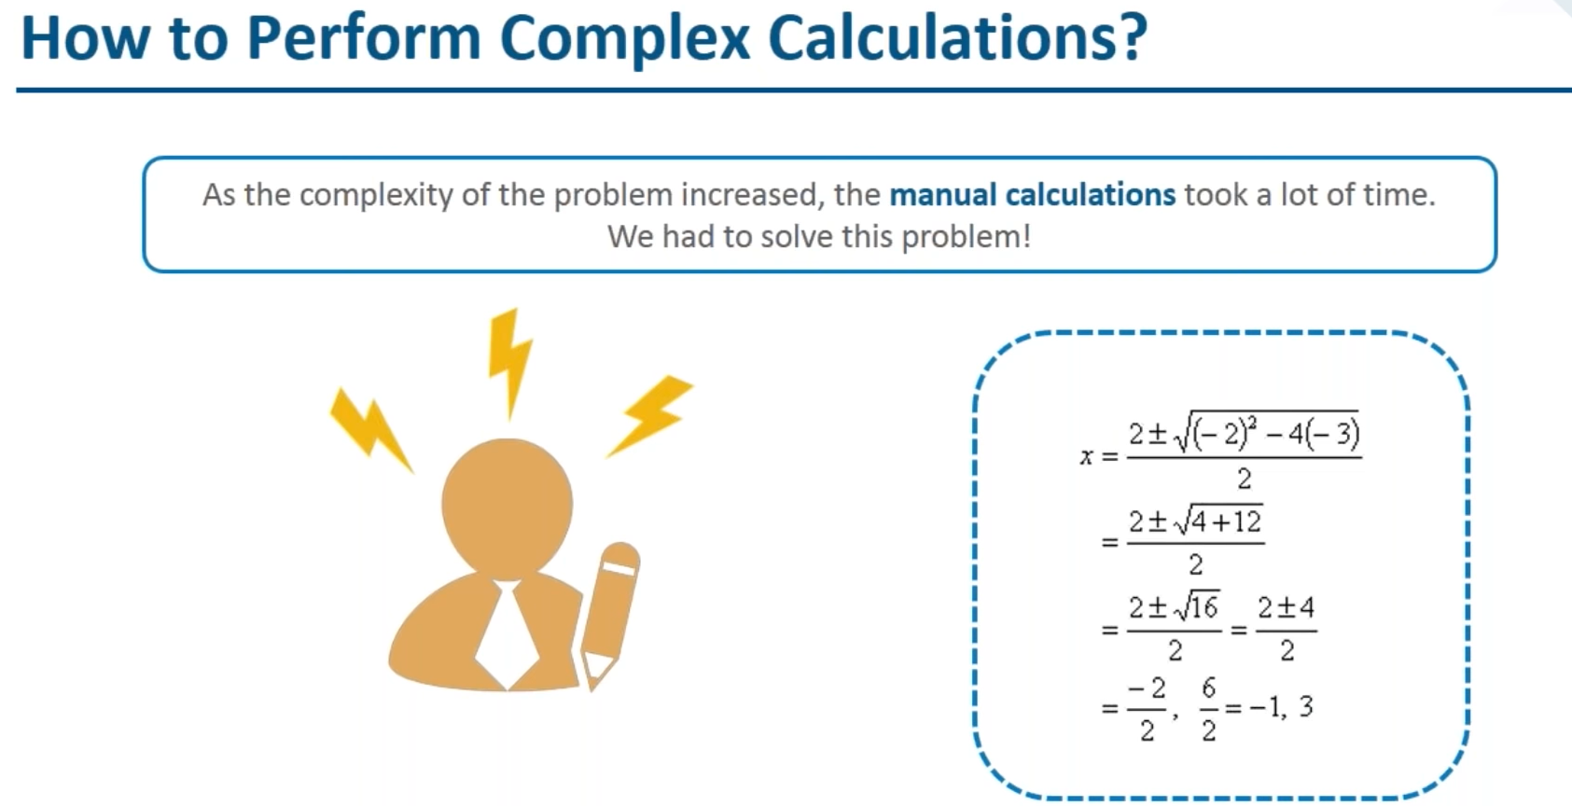

Slide 19
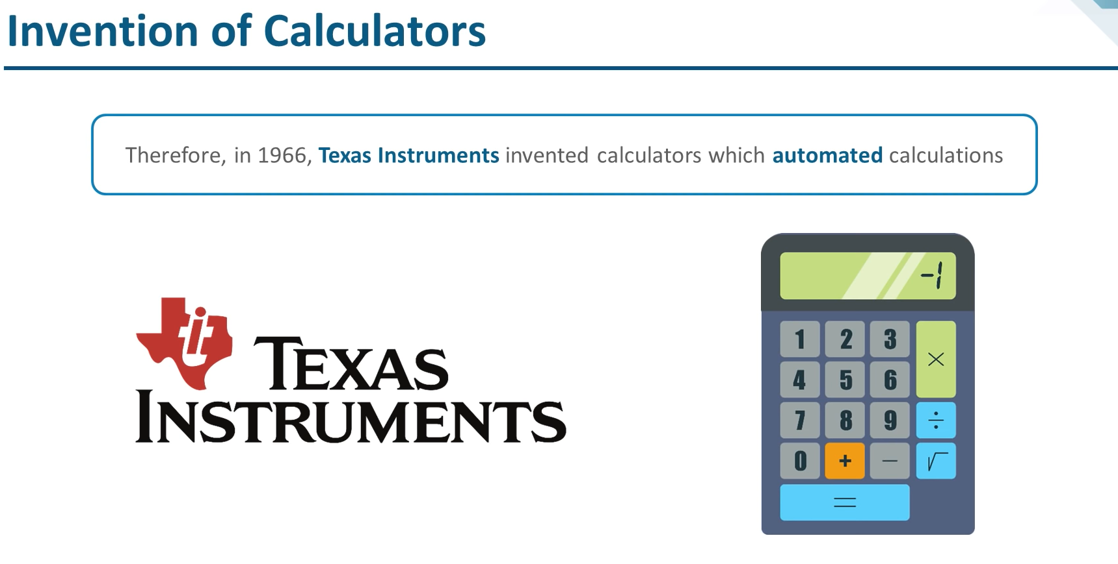

Slide 20
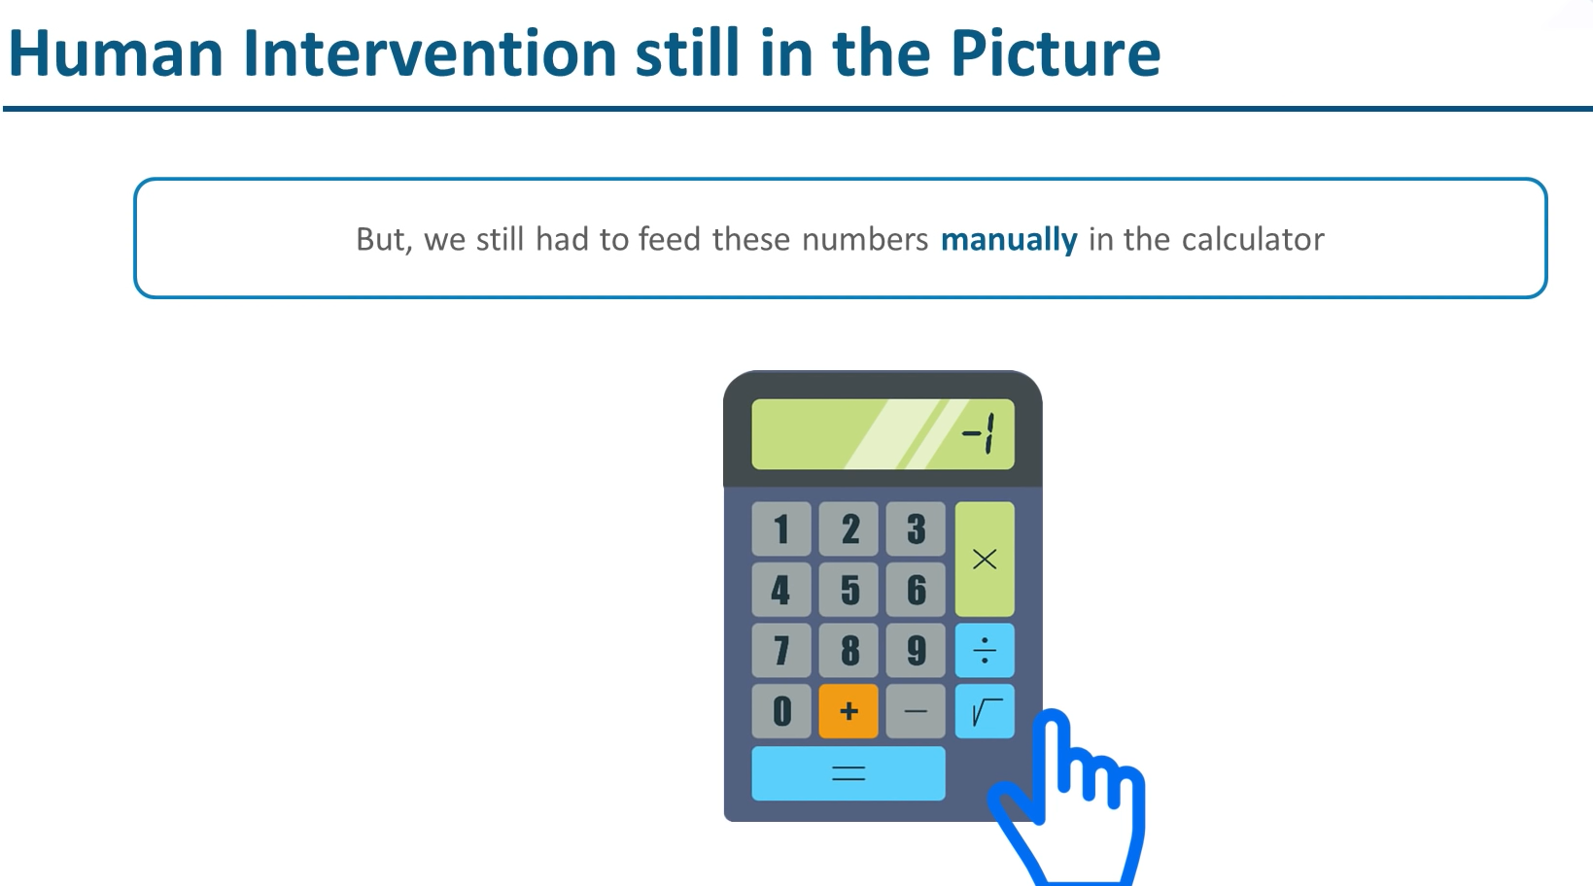

Slide 21
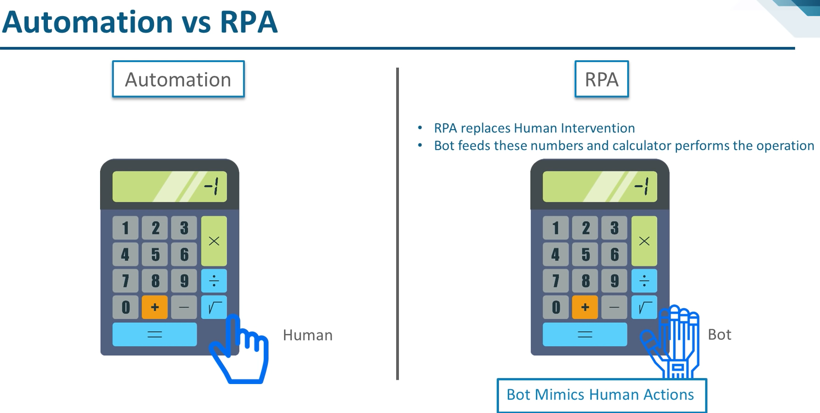

Slide 22
Processes & Flowcharts
1. There are typically two ways to represent a process:
▪ As a sequence, where actions come one after the other
▪ As a flowchart, where there are multiple decision points and logical branches
2. The process chosen for automation is split into simple actions and mapped in the RPA tool.
3. The RPA developer analyzes and configures the mapped process by introducing decision points, variables, pre-defined operations, and other types of elements available in the RPA tool.
4. Once the logic is replicated in the workflow, the process is ready for automation.

